Slide 1




NEXT GEN EMPLOYABILITY PROGRAM
Creating a future-ready workforce
Team Members
College Name
Student Name : Dinisha Shyrine.G
Student ID : au960221104301
Arunachala College of Engineering for Women

Slide 2

CAPSTONE PROJECT SHOWCASE
Project Title
Car Rentals Application with Django Framework
Abstract | Problem Statement | Project Overview | Proposed Solution | Technology Used | Modelling & Results | Conclusion

Slide 3
Abstract
The Car Rentals Application with Django Framework is designed to facilitate efficient management and booking of rental cars for both customers and administrators. Leveraging the Django web framework, this application offers a seamless user experience through its intuitive interface and robust backend functionality. Users can easily search for available cars based on various criteria such as location, date, and vehicle type, and make reservations with just a few clicks. Administrators have access to powerful tools for managing inventory, monitoring bookings, and generating reports to optimize business operations. By employing Django's built-in security features and scalability, this application ensures data integrity and performance even under heavy loads. Overall, the Car Rentals Application demonstrates the capability of Django Framework in developing sophisticated web applications tailored to specific business needs in the transportation industry.
Source :

Slide 4
Problem Statement
The problem is to create a dynamic website for Car Rental System
Current car rental systems lack efficiency and user-friendliness, resulting in frustration for customers and inefficiencies for businesses. A need exists for a comprehensive solution with seamless user experiences and robust backend functionality to revolutionize the car rental industry.
Source :

Slide 5
Project Overview
Here is the overview for the project:
Planning and Requirements Gathering: Begin by defining project objectives and gathering requirements for the car rental website.
Designing User Interface: Design the frontend of the website using HTML, CSS, and JavaScript to create an intuitive and visually appealing user interface.
Backend Development with Django: Set up the backend infrastructure using Django, a high-level Python web framework. Develop models for cars, users, bookings, and other relevant entities, along with appropriate database schema.
Admin Panel Development: Create an admin panel using Django's admin interface or custom admin views to enable administrators to manage cars, bookings, users, and other aspects of the system efficiently.
Source :

Slide 6
Proposed Solution
.
To create a car rental system using frontend tools like HTML, CSS, and JavaScript, combined with backend tools like Python and Django, you can follow these steps:
Design the User Interface (UI):
Use HTML to structure the web pages, including forms for user input.
Apply CSS for styling to make the interface visually appealing and user-friendly.
Utilize JavaScript for client-side interactivity, such as form validation and dynamic content updates.
Backend Development with Django:
Set up a Django project and create Django apps for different functionalities (e.g., user authentication, car rental management).
Define models for storing data related to users, cars, reservations, etc.
Implement views to handle user requests and interact with data through Django's ORM.
Configure URLs to map requests to appropriate views.

Slide 7
3.User Authentication:
Implement user authentication and authorization using Django's built-in authentication system or third-party libraries like Django Allauth.
Allow users to sign up, log in, and manage their accounts.
4.Car Rental Functionality:
Develop features for users to browse available cars, view details, and make reservations.
Create forms for users to specify rental dates, pickup/drop-off locations, and other preferences.
Implement business logic to check availability, calculate rental fees, and process reservations.
5.Admin Panel:
Build an admin interface using Django's admin site to manage cars, users, reservations, etc.
Provide functionalities for admins to add new cars, update details, and handle reservations.
6.Integration:
Connect the frontend and backend by making HTTP requests from the frontend to backend APIs using JavaScript.
Handle responses and update the UI accordingly, providing feedback to users.
Source :

Slide 8
7.Testing and Debugging:
Test the system thoroughly to ensure functionality, security, and performance.
Debug any issues that arise during testing and make necessary adjustments.
8.Deployment:
Deploy the application to a hosting platform such as Heroku, AWS, or DigitalOcean.
Configure the server environment and database settings for production use.
By following these steps, you can create a robust car rental system that seamlessly integrates frontend and backend technologies to provide users with a smooth and efficient experience.
Source :

Slide 9


Technology Used
Front-end
Back-end
Source :

Slide 10
Modelling & Results
The user model captures essential attributes like username, email, and password, with additional details including first name, last name, and contact information. Meanwhile, the car model encompasses key features such as make, model, year, color, and price per day, complemented by an image URL and description. Lastly, the reservation model links users and cars via foreign keys, with fields for start and end dates, pickup and drop-off locations, total price, and reservation status for streamlined booking management.
The project delivers a user-friendly car rental system enabling users to sign up, browse cars, make reservations, and manage their accounts, with admins having tools to manage inventory and bookings. It integrates frontend and backend interactions for seamless user experiences, undergoes rigorous testing, and is deployed for public access, ensuring functionality, security, and usability.
Source :

Slide 11
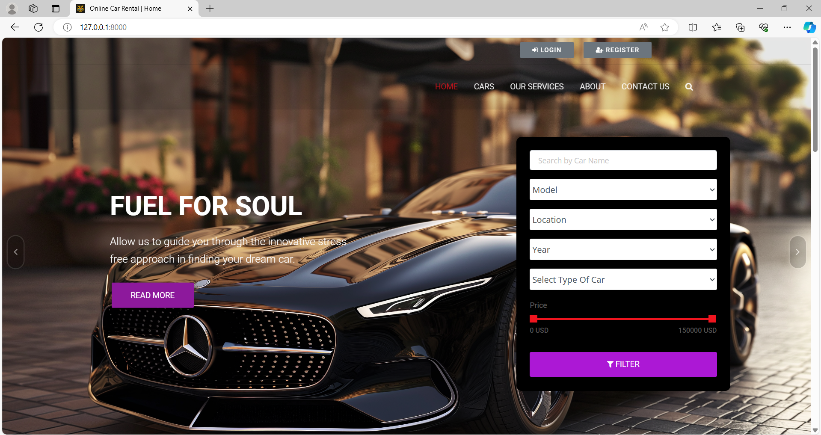
Homepage

Slide 12
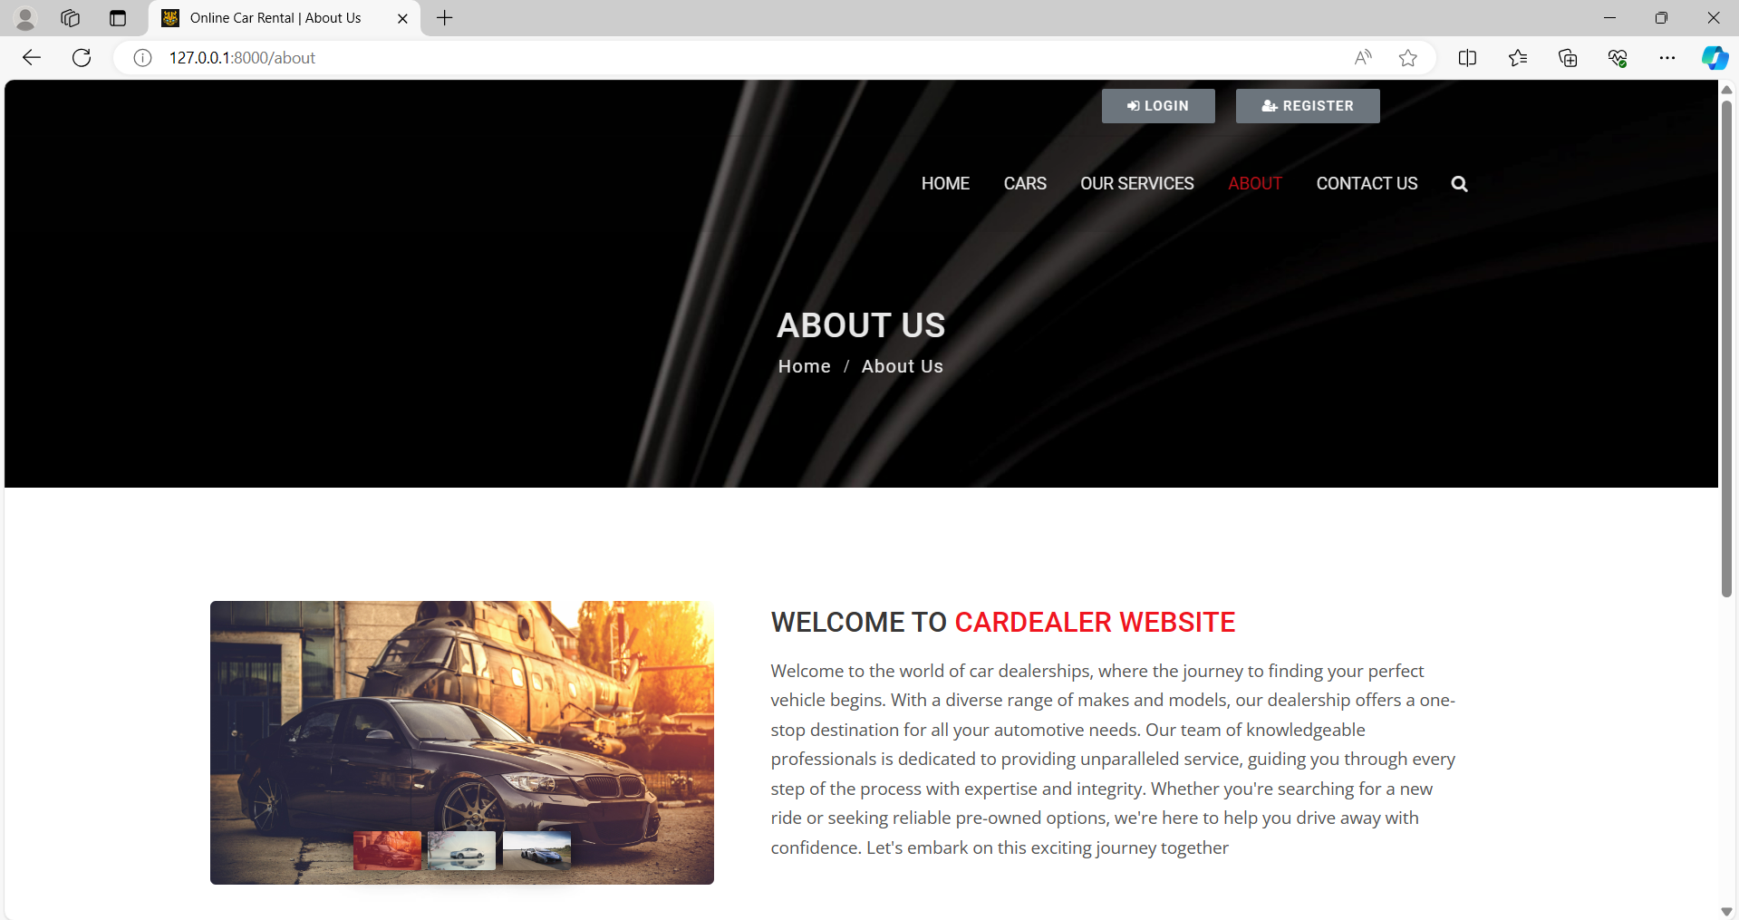
About-Us-Page

Slide 13
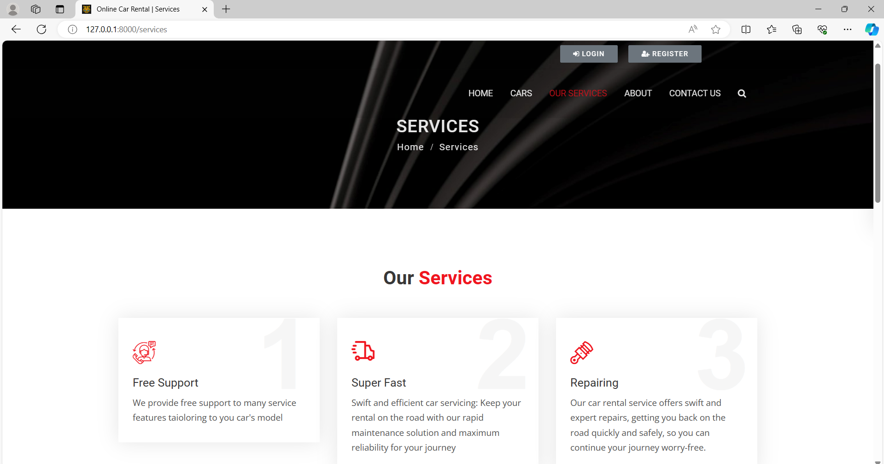
Service-Page

Slide 14
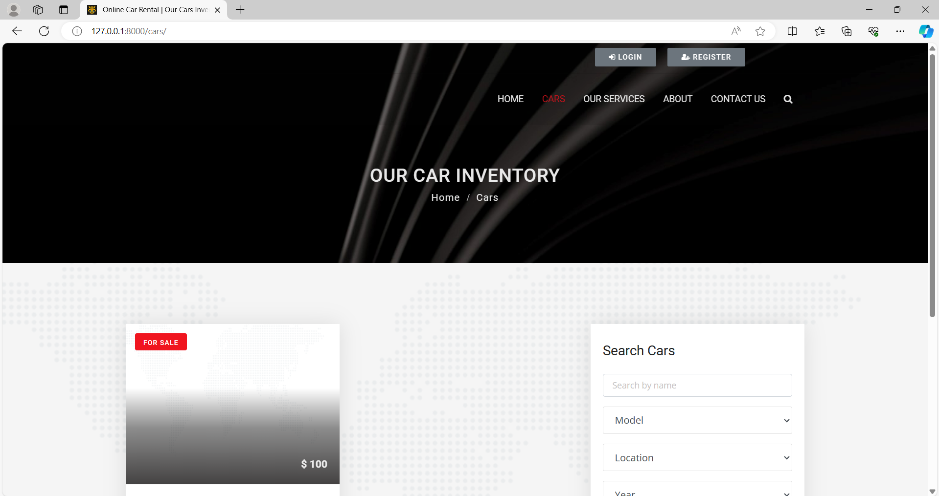
Cars-Page

Slide 15
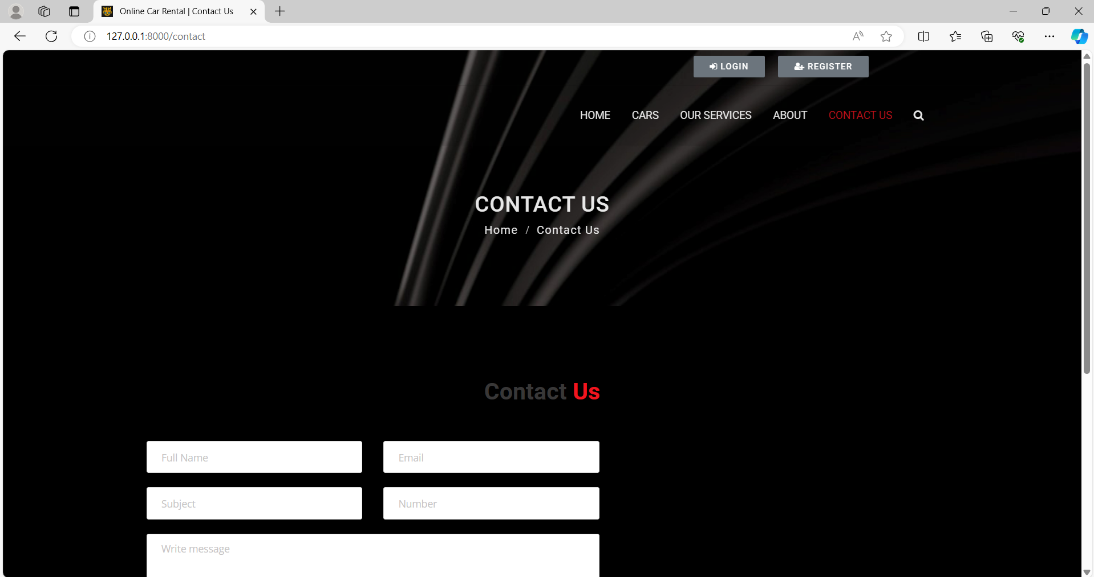
Blog-Page

Slide 16
Future Enhancements:
Mobile App Development: Expand the platform by developing dedicated mobile applications for both Android and iOS devices, offering users the convenience of renting cars on the go.
Integration of AI and ML: Implement artificial intelligence and machine learning algorithms to analyze user preferences and behavior, providing personalized recommendations for car selections and improving the overall user experience.
Enhanced Fleet Management: Introduce advanced fleet management features for administrators, including predictive maintenance scheduling, real-time tracking of vehicle locations, and optimization of car allocation based on demand patterns.
Incorporation of IoT: Utilize Internet of Things (IoT) technology to equip rental cars with sensors for monitoring various parameters such as fuel levels, engine health, and vehicle diagnostics, enabling proactive maintenance and optimizing operational efficiency.
Expansion of Services: Diversify the services offered beyond traditional car rentals, such as incorporating options for car-sharing, ride-hailing partnerships, or integrating electric and hybrid vehicles into the fleet to cater to eco-conscious customers.

Slide 17
Conclusion
In conclusion, the car rental system project presents a comprehensive solution for facilitating smooth and efficient vehicle rentals. With a user-friendly interface allowing for easy browsing, booking, and management of reservations, coupled with robust backend functionalities for inventory management and administrative control, the system aims to streamline the rental process for both users and administrators. Future enhancements such as mobile app development, integration of AI and IoT technologies, and expansion of services offer promising avenues for further improving the system's functionality, user experience, and market competitiveness. Through rigorous testing, deployment, and ongoing refinement, the project endeavors to deliver a reliable, secure, and innovative platform that meets the evolving needs of the car rental industry and ensures customer satisfaction.
Source :

Slide 18
Thank You!
Notes:
Thank You !!

